Slide 1
CSI ZG515/ SS ZG515 Data Warehousing
Swarna Chaudhary
Assistant Prof.

Slide 2

The slides presented here are obtained from the authors of the books and from various other contributors. I hereby acknowledge all the contributors for their material and inputs.
I have added and modified a few slides to suit the requirements of the course.

Slide 3
Metadata

Slide 4
Outline
Metadata
Types of Metadata

Slide 5
Metadata
The first image most people have of the data warehouse is a large collection of historical, integrated data.
While that image is correct in many regards, there is another very important element of the data warehouse that is vital – metadata
Metadata is data about data
Not a new concept – has been around as long as there have been programs and the data on which these programs operate

Slide 6
Metadata
Data about the data
Table of contents of data
Catalog for the data
DW Atlas
DW Roadmap
DW Directory
Glue that holds the DW together
Tongs to handle the data
The nerve center

Slide 7
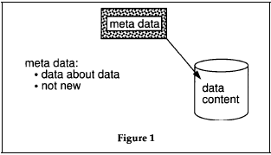
Metadata

Slide 8
Metadata
It is all the information that defines and describes the structures, operations, and contents of a DW system
- Ralph Kimball, The DW Lifecycle Toolkit, 2e, Wiley, 2008

Slide 9
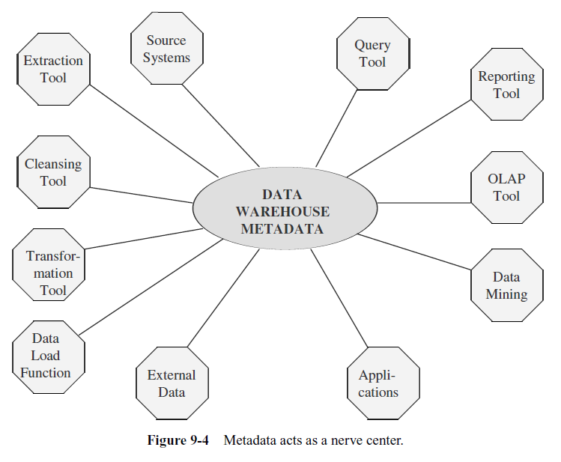

Slide 10
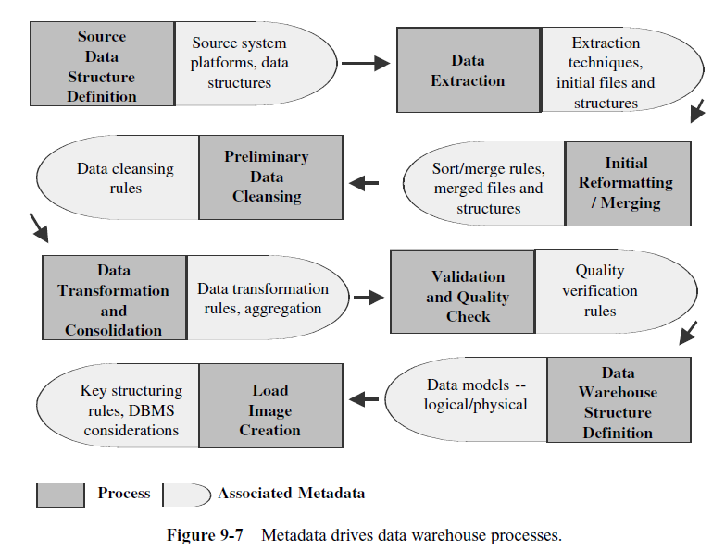

Slide 11
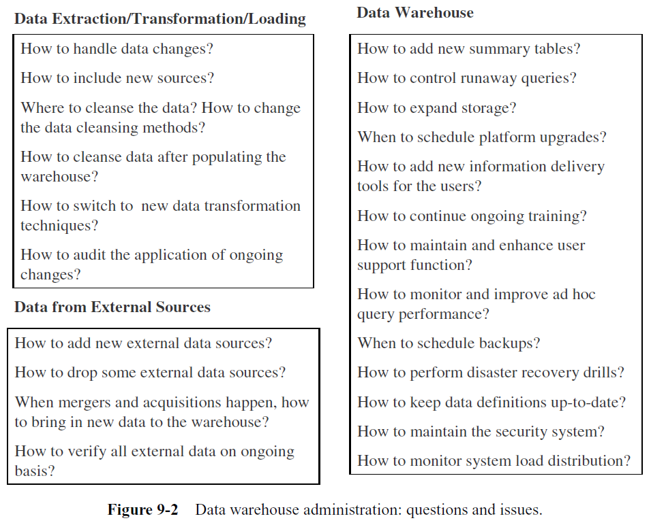

Slide 12
Metadata
Information about the table/entity “Customer”
Entity Name: Customer
Alias Names: Account, Client
Defn.: A person or an organization that purchases goods or services from the company
Remarks: Regular, current, & past customers
Source Systems: Finished goods orders, Maintenance contracts
Create Date: Jan. 23, 2010
Last update Date: Jan. 21, 2012
Update Cycle: Weekly
Last full refresh cycle: Dec. 29, 2011
Full refresh cycle: every 6 months
Data Quality reviewed: Jan. 25, 2012
Planned archival: every 6 months
Responsible User: ABC

Slide 13
Categories of Metadata
Operational Metadata
Extraction and Transformation Metadata
End-User Metadata

Slide 14
Types of Metadata
Data Acquisition
Data Storage
Information Delivery
Another Classification:
Business Metadata
Technical Metadata

Slide 15
Metadata Classification
Classification by functional areas in the DW
Data Acquisition
Data Storage
Information Delivery
Every DW process occurs in one of these three areas

Slide 16
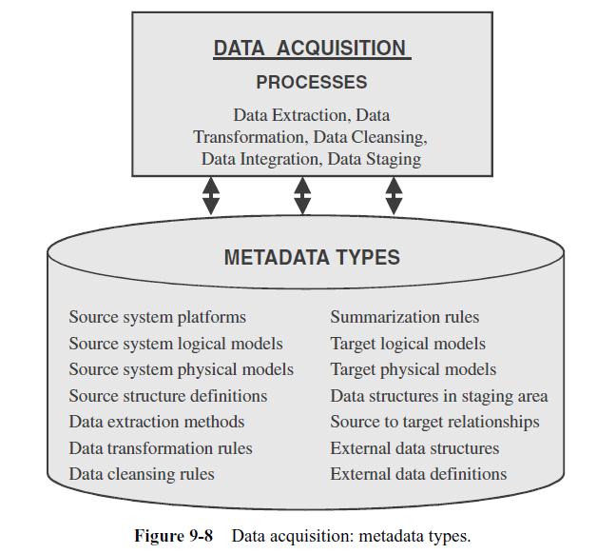
Data Acquisition

Slide 17
Data Acquisition Metadata
Development tools are used to record metadata
Other tools used in this area or in some other area may use the metadata recorded by other tools in this area
For example: when a query tool is used to create standard queries, you will be using metadata recorded by processes in the data acquisition area (query tool is meant for a process in the Information Delivery area)

Slide 18
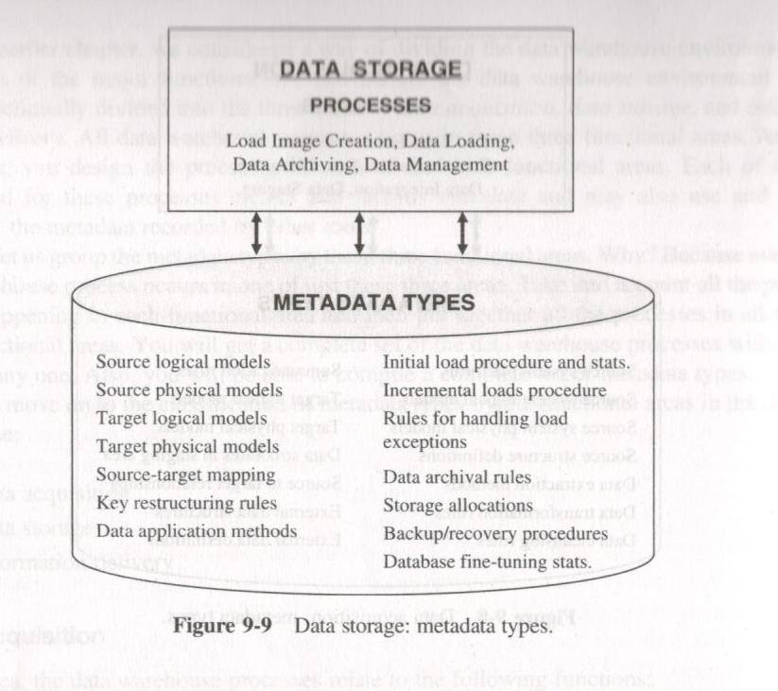
Data Storage

Slide 19
Data Storage Metadata
The tools record the metadata elements during the development phases as well as while the data warehouse is in operation after deployment
Metadata used for development, administration, and by the users
Used for full data refreshes and incremental data loads
DBA will use for processes of recovery, backup, and tuning
For purging and archiving of data
User wanting to do a drill-down from total quarterly sales to sales districts, would want to know about when was the last time the data on district delineation was loaded

Slide 20
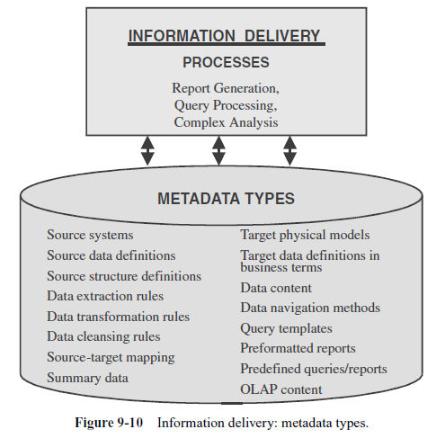
Information Delivery

Slide 21
Information Delivery Metadata
Most of the processes in this area are meant for end users
While using the processes, end-users generally use metadata recorded in processes of the other two areas of data acquisition and data storage.
When a user creates a query with the aid of a query processing tool, he or she can refer back to metadata recorded in the data acquisition and data storage areas
can look up the source data configurations, data structures, and data transformations from the data acquisition area metadata
can look up date of last full refresh and the incremental loads for various tables from the data storage area metadata

Slide 22
Metadata: Another Classification
Business Metadata
Technical Metadata

Slide 23
Business Metadata
Describes the content of the DW in more user accessible terms
What data you have, from where it came, what it means and its relationship with other data in the DW
Display name & content description fields
Often serves as documentation for DW system
May include additional layers of categorization that simplifies user’s view
Subsetting tables into business process oriented groups
Grouping related columns in a dimension
Metadata models used by major BI tools provide these kinds of groupings
When users browse the metadata to see what is there in the DW, they are primarily viewing business metadata

Slide 24
Examples of Business Metadata
Connectivity procedures
Security and access privileges
The overall structure of data in business terms
Source systems
Source-to-target mappings
Data transformation business rules
Summarization and derivations
Table names and business definitions
Attribute names and business definitions

Slide 25
Examples of Business Metadata
Data ownership
Query and reporting tools
Predefined queries
Predefined reports
Report distribution information
Common information access routes
Rules for analysis using OLAP
Currency of OLAP data
Data warehouse refresh schedule

Slide 26
Business Metadata
A representative list of questions a business user can ask from the business metadata:
How can I sign onto and connect with the data warehouse?
Which parts of the data warehouse can I access?
Can I see all the attributes from a specific table?
What are the definitions of the attributes I need in my query?
Are there any queries and reports already predefined to give the results I need?
Which source system did the data I want come from?
What default values were used for the data items retrieved by my query?

Slide 27
Business Metadata
A representative list of questions a business user can ask from the business metadata:
What types of aggregations are available for the metrics needed?
How is the value in the data item I need derived from other data items?
When was the last update for the data items in my query?
On which data items can I perform drill down analysis?
How old is the OLAP data? Should I wait for the next update?

Slide 28
Business Metadata
Who benefits?
Managers
Business analysts
Power users
Regular users
Casual users
Senior managers/junior executives

Slide 29
Technical Metadata
Defines the objects and processes that make up the DW system from a technical perspective
System metadata:
Defines data structures
Table, fields, indexes, and partitions in the relational engine
Databases, dimensions, and measures
In the ETL process:
Source & target for a particular task
Transformations (including business rules and data quality screens) and their frequency
Front room:
Defines the data model
How data is displayed to the users
Some technical metadata elements are useful for the business users like table and column names
Definition of a table partition functions is of no interest to business user

Slide 30
Examples of Technical Metadata
Data models of source systems
Record layouts of outside sources
Source-to-staging area mappings
Staging area-to-data warehouse mappings
Data extraction rules and schedules
Data transformation rules and versioning
Data aggregation rules
Data cleansing rules
Summarization and derivations
Data loading and refresh schedules and controls
Job dependencies
Program names and descriptions
Data warehouse data model
Database names

Slide 31
Examples of Technical Metadata
Table/view names
Column names and descriptions
Key attributes
Business rules for entities and relationships
Mapping between logical and physical models
Network/server information
Connectivity data
Data movement audit controls
Data purge and archival rules
Authority/access privileges
Data usage/timings
Query and report access patterns
Query and reporting tools

Slide 32
Technical Metadata
What databases and tables exist?
What are the columns for each table?
What are the keys and indexes?
What are the physical files?
Do the business descriptions correspond to the technical ones?
When was the last successful update?
What are the source systems and their data structures?
What are the data extraction rules for each data source?
What is source-to-target mapping for each data item in the data warehouse?
What are the data transformation rules?

Slide 33
Technical Metadata
What default values were used for the data items while cleaning up missing data?
What types of aggregations are available?
What are the derived fields and their rules for derivation?
When was the last update for the data items in my query?
What are the load and refresh schedules?
How often data is purged or archived? Which data items?
What is schedule for creating data for OLAP?
What query and report tools are available?

Slide 34
Technical Metadata
Who benefits?
Project manager
Data warehouse administrator
Database administrator
Metadata manager
Data warehouse architect
Data acquisition developer
Data quality analyst
Business analyst
System administrator
Infrastructure specialist
Data modeler
Security architect

